Slide 1

Database Design and Querying

Slide 2


Course: Data Analysis Toolkit
Lecture On: Database Design and Querying
Instructor:

Slide 3
SOME GUIDELINES
Prerequisites - Learners are expected to have all the prerequisites required for this session
Focus - Learners are expected to concentrate during the session
Tools - Learners are expected to keep ready and use pen and paper, calculator
Chat - Civil and disciplined chat is encouraged
Quizzes - Learners are expected to solve all quizzes in real-time and share their answers
Break - Learners might get a 5-10 minute break during mid-time depending on the nature of the session
Polls - Learners are requested to give feedback using the mid-poll and end-poll
Reading - Learners are expected to do additional reading as instructed by the lecturers

Slide 4
Agenda
Entity Relationship Diagrams
Relationships in ERD
Schema and its Types
SQL Commands

Slide 5
ENTITY RELATIONSHIP DIAGRAM (ERD)
Representation of the tables in a database
Gives us an idea of how different entities are connected
Extremely useful to get an overall idea of a database in a short time

Slide 6
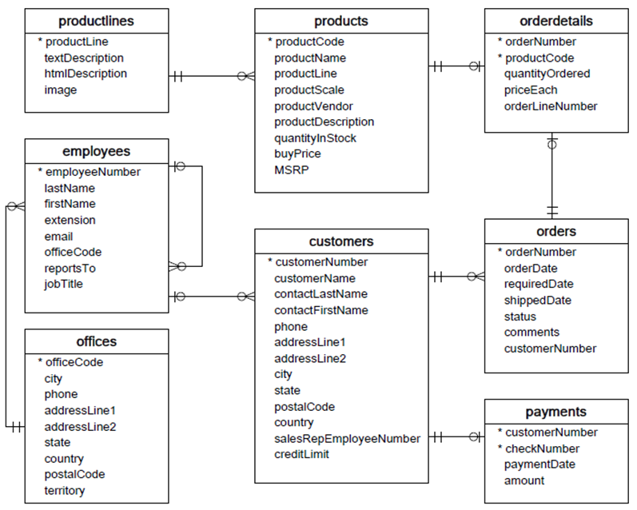
ENTITY RELATIONSHIP DIAGRAM (ERD) - Example
Fields marked with a star are the primary keys for each table
A line connecting two tables indicates that a relationship exists between them
A line connecting a table to itself indicates that the table references itself

Slide 7
Entity and Attributes
Entity
CUSTOMERS
Customer_ID
Name
Email
Age
Attributes
Notes:
Entity : Entities are used to represent classes or objects in the real world, this could be people or products.
Attributes: the features of an entity are attributes.

Slide 8
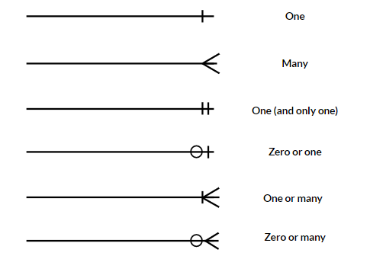
RELATIONSHIPS
They are the lines between the tables in an ERD diagram
They define the relationships among the tables

Slide 9

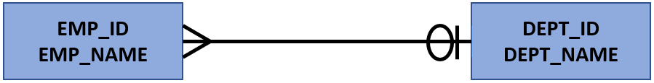
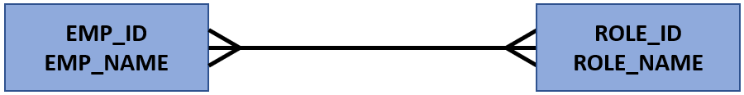
RELATIONSHIPS
An ERD has three types of relationships:
One to one
Many to one or one to many
Many to many
Notes:
One to One: One to one type of relationship exists, when a single instance of an entity is related to only a single instance of another entity.
One to Many: One to many type of relationship exists, when a single instance of an entity is related to more than one instance of another entity.
Many to One: Many to one type of relationship exists, when more than one instance of an entity is related to only one instance of another entity.
Many to Many: Many to many type of relationship exists, when more than one instance of an entity is related to more than one instance of another entity.

Slide 10
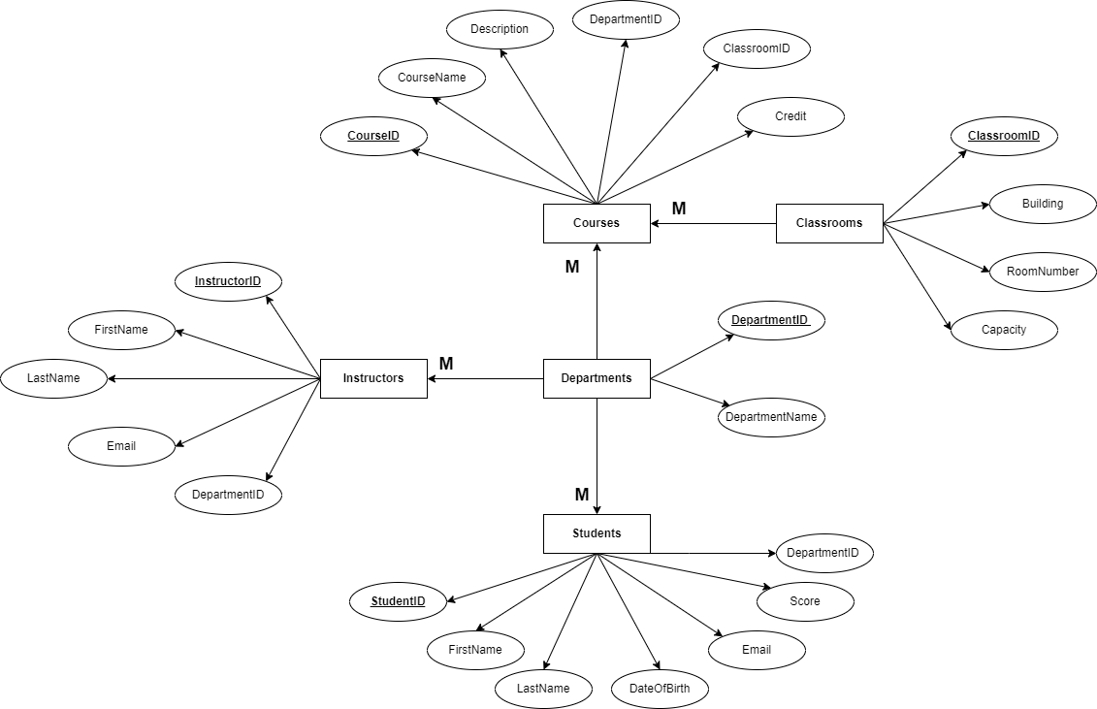
Example

Slide 11
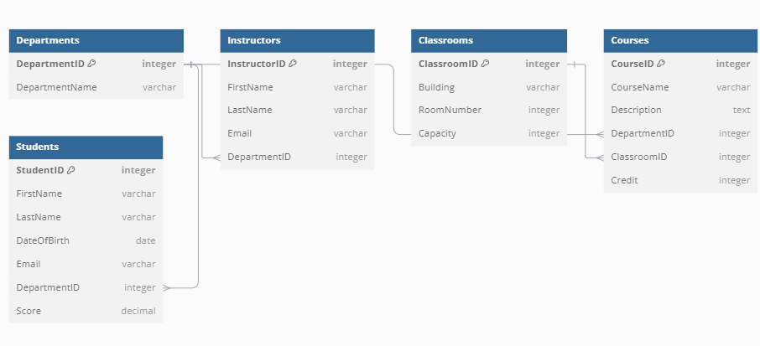

Slide 12
SCHEMA
Tables
Hold data
Can be considered as a blueprint of the database and data warehouse
Database Schema:
Logical description of organization & structure of database
Warehouse Schema:
Template for constructing and organizing data tables in data warehouse
Views
Virtual representation of parts of data tables
Columns
Attributes that define data
SCHEMA
Constraints
Rules/conditions on the stored data
Relationships
How tables are connected
Notes:
The main components of a schema are:
Tables: central building blocks, hold data
Columns: attributes defining data elements within a table. Ex: Name, Email, Age
Constraints: rules/conditions on the data stored to ensure consistency and integrity. Ex: Primary Key
Relationships: define how tables are connected to each other
Views: virtual representation of some part of data tables
There are two types of tables: Central fact tables (having Facts) and dimension tables (consisting of Dimensions)

Slide 13
TYPES OF SCHEMA
STAR
SNOWFLAKE
Dimension Table
Dim Table L2
Dim Table L2
Dim Table L2
Dim Table L1
Dim Table L2
Dimension Table
Dimension Table
Dim Table L1
Dim Table L1
Fact Table
Dim Table L2
Fact Table
Dim Table L2
Dim Table L2
Dim Table L1
Dim Table L1
Dim Table L2
Dimension Table
Dimension Table
Dim Table L2
Dim Table L1
Dim Table L2
Dim Table L2
Dim Table L2
The central fact table is surrounded by multiple dimension tables.
It simplifies querying but may lead to some data redundancy.
Dimension tables are organized into multiple related tables.
The snowflake schema extends the star schema by dividing dimension tables.
Reduces redundancy but can make the schema more complex.
Notes:
Central Fact Table:
A central fact table is a key component of the star schema or snowflake schema.
The central fact table contains quantitative data (also known as facts or measures). These facts represent business events, transactions, or metrics that can be analyzed.
Structure:
The central fact table typically includes foreign keys that link to various dimension tables.
These foreign keys establish relationships between the facts and the attributes stored in dimension tables.
Purpose:
The central fact table serves as the hub for analyzing data. It provides a consolidated view of business performance and allows for efficient querying and reporting.
Dimension Tables:
Dimension tables contain descriptive attributes related to the data being analyzed.
These attributes provide context and categorization for the facts stored in the central fact table.
Examples of Dimension Tables:
People, Products, Locations, Time etc.
Characteristics:
Dimension tables are relatively smaller in size compared to the central fact table.
They contain descriptive data that helps interpret the facts.
Attributes in dimension tables are often used for filtering, grouping, and labeling in queries.
In a bank, for a loan database, the loan amounts, interest rates etc. are in dimension tables, but details like which loan is associated with which account number are stored in fact tables.

Slide 14
Star Schema | Snowflake Schema
In star schema, the fact tables and the dimension tables are contained | The fact tables, dimension tables and sub-dimension tables are contained
Star schema is a top-down model | It is a bottom-up model
Star schema uses more space | It uses less space
It takes less time for the execution of queries | It takes more time than star schema for the execution of queries
In star schema, normalization is not used | Both normalization and denormalization are used
Its design is very simple | Its design is complex
The query complexity of star schema is low | The query complexity of snowflake schema is higher than that of star schema
Its understanding is very simple | Its understanding is difficult
It has less foreign keys | It has more foreign keys
It has high data redundancy | It has low data redundancy
Notes:
How does snowflake schema use less space even after so many tables? By reducing the number of data points
Foreign keys are just mappings to other tables.

Slide 15
SQL Commands

Slide 16
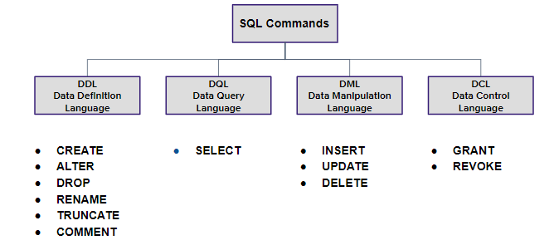
TYPES OF SQL COMMANDS

Slide 17
PURPOSE OF SQL COMMANDS
DDL - Helps in designing and structuring the database objects like tables.
DQL - Helps in getting data from databases using the SELECT statement
DML - Helps in managing and modifying the data in tables.
DCL - Helps in controlling the access to data within a database.

Slide 18
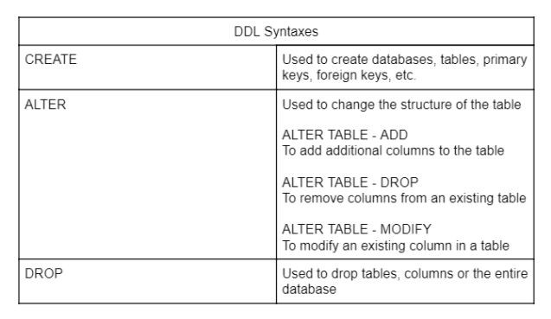
28
DDL Statements

Slide 19
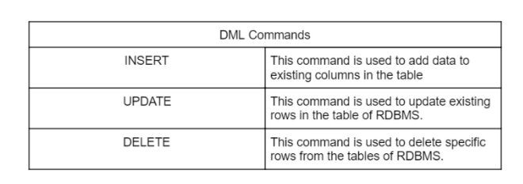
DML Statements
29

Slide 20
Thank you!

